Slide 1
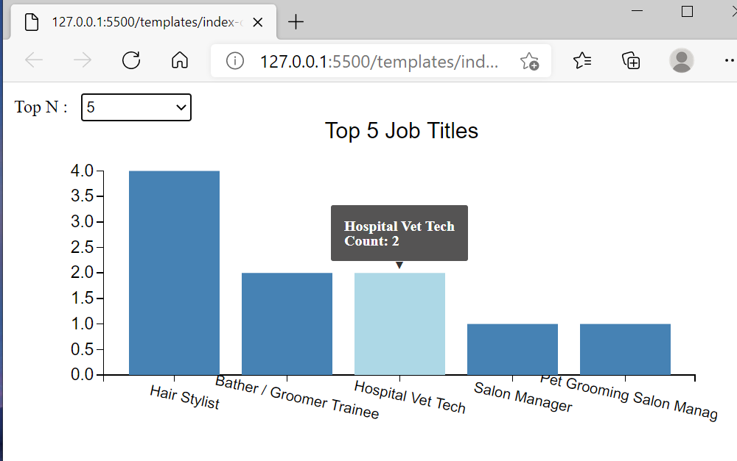
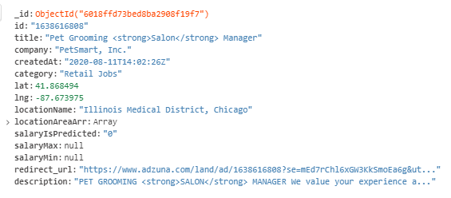
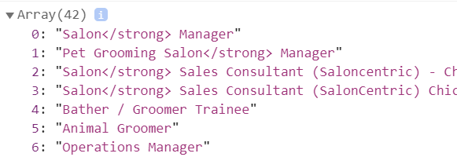

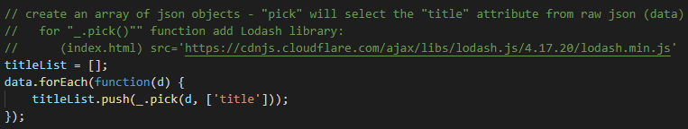
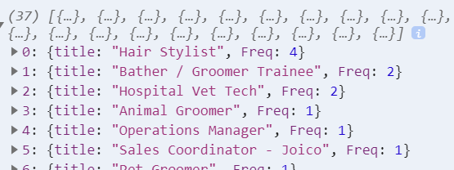

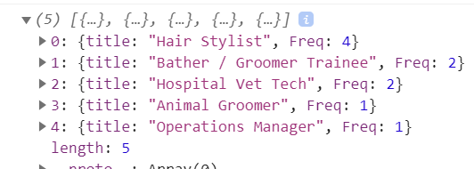



Grooming Data for Top-N

Slide 2

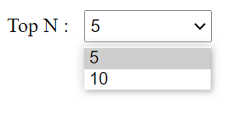

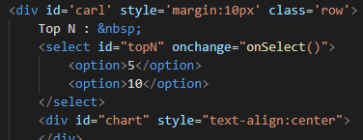

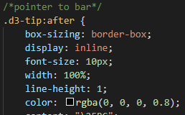
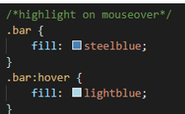
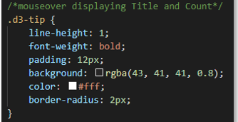
Charting Top-N with D3/SVG

Slide 3
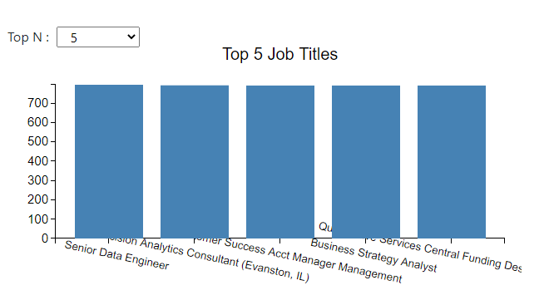
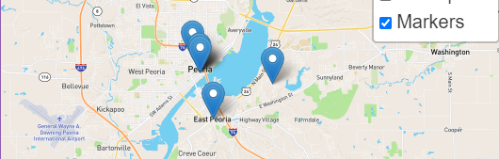
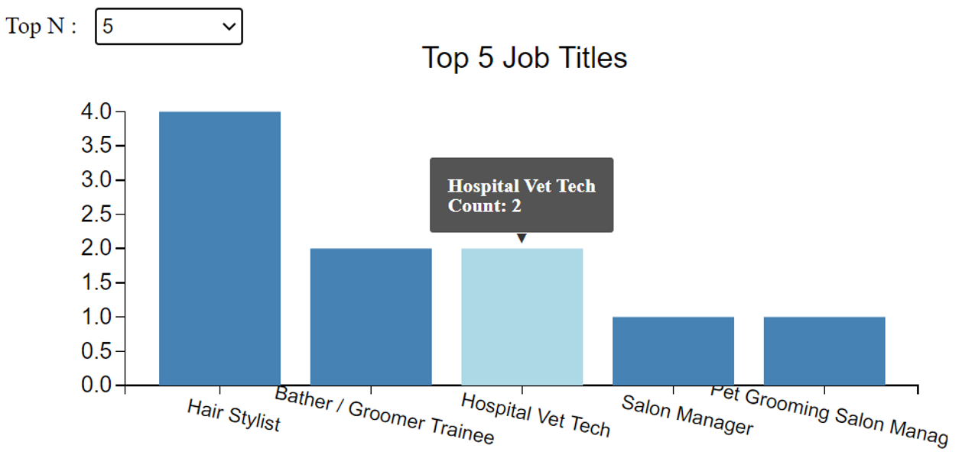
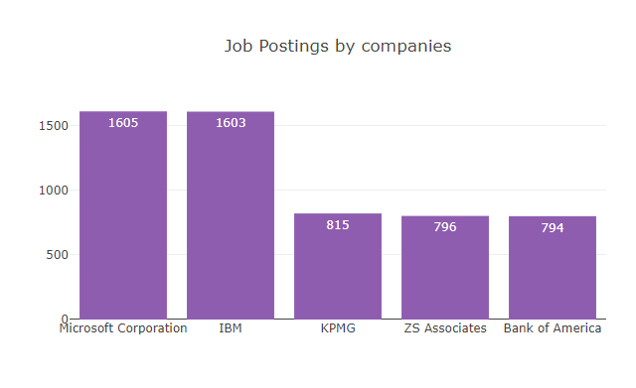
Based on the search criteria, several questions are answered
What are the top 5 Job Titles?
Where are the companies located?
What are the top 5 companies that have the most jobs for the selected job title?

Slide 4






Project Challenges
Getting data
Getting data:
API’s required a paid subscription
Indeed (restricted number of pages)
LinkedIn
Glass Door
ParsHub
Decided on an API for Adzuna - salary info was generally null
Running out of our API data, exceeding our daily limit
Getting good data from the API; Less than 5% had salary data

